Slide 1
GET TO KNOW FACT OREGON
Larana, Inc.
02.16.2023

Slide 2
ABOUT FACT OREGON
FACT Oregon empowers families and youth with disabilities to pursue a whole life and transforms how people think about disability.
We are the federal and state designated Parent Training & Information Center (PTI) for Oregon.
Notes:
What is a whole life? For some, that means having stable employment,

Slide 3
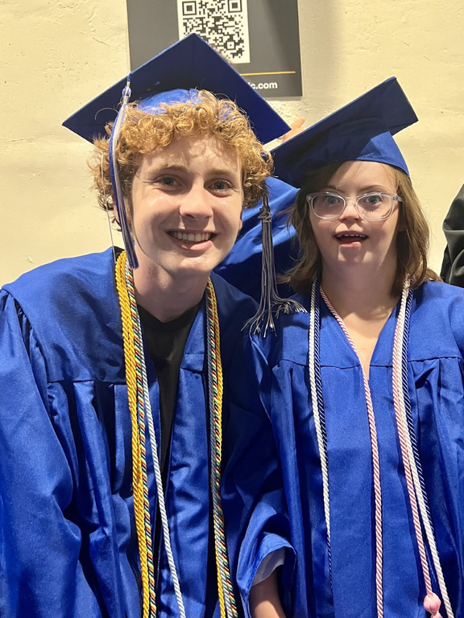
WHO WE SERVE
Families of children and youth with disabilities
Youth and individuals with disabilities
Community organizations, educators, policymakers, and others who engage and serve families and youth with disabilities.

Slide 4
HOW WE DO IT
Disrupt Ableism
Disrupt ableism and change how people think about disability.
FACT Oregon strives to help families hold high expectations for their children, set a path for a whole, full life, and take steps with their youth to make that vision possible.
Self-determination
Highlight the importance of self-determination and whole lives.
Support
Help families support children's growth and well-being in school, at home, and in community.
Equip
Equip families, youth, and partners to navigate systems, services, and community resources.

Slide 5
KEY PROGRAMS AND SERVICES
SUPPORT LINE
TRAININGS
OUTREACH
TECHNICAL
ASSISTANCE
ADVOCACY
Specialists (all parents) answer questions and provide information to families and partners on special education, disability services, and community resources.
We offer trainings on ableism, special education, inclusive practices, disability services, and whole life planning.
We connect with families and partners through community events, resource fairs, eblasts, social media, and committee and coalition work.
We help community partners understand ableism, whole lives, self-determination, and disability related systems and services so they can better serve families and youth in their communities.
We bring family and youth voice to decision-making tables through parent leadership programs and public advocacy work.

Slide 6
Email
CONNECT WITH US!
Call
Email
Website
Social Media
Schedule
(503) 786-6082 (541) 695-5416
support@factoregon.org
apoyo@factoregon.org
www.factoregon.org
factoregon
factoregon.org

